Slide 1


WEBINAR ON THE
Rapid and Living Evidence Synthesis for Environmental Action:
Best Practices and Next Steps
27 April 2026 | 14.00–16.00 CEST

Slide 2


WEBINAR ON THE
Rapid and Living Evidence Synthesis for Environmental Action: Best Practices and Next Steps
WELCOME & INTRODUCTION
Dr. Diana Potjomkina
Senior Policy Officer for the Green Transition, Science Europe

Slide 3

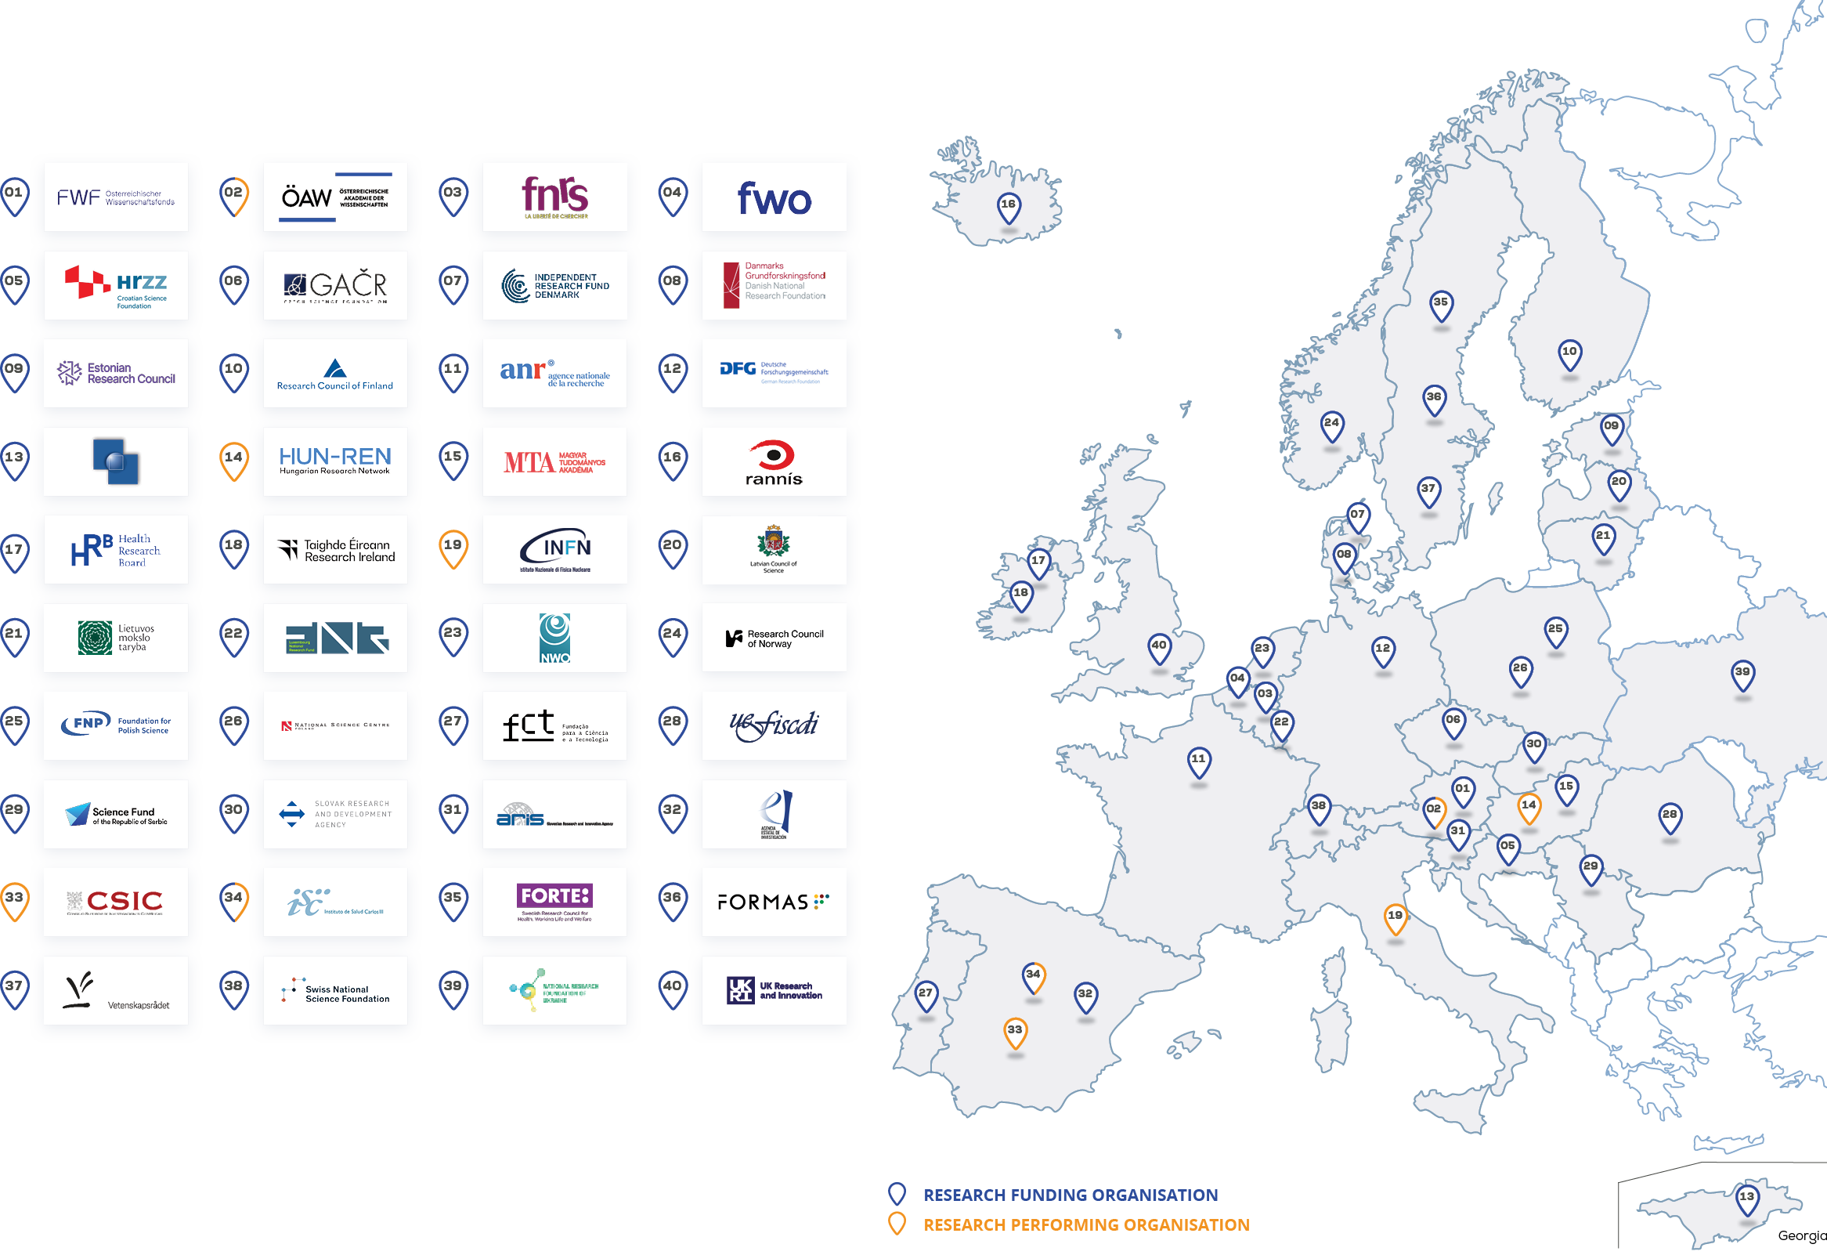
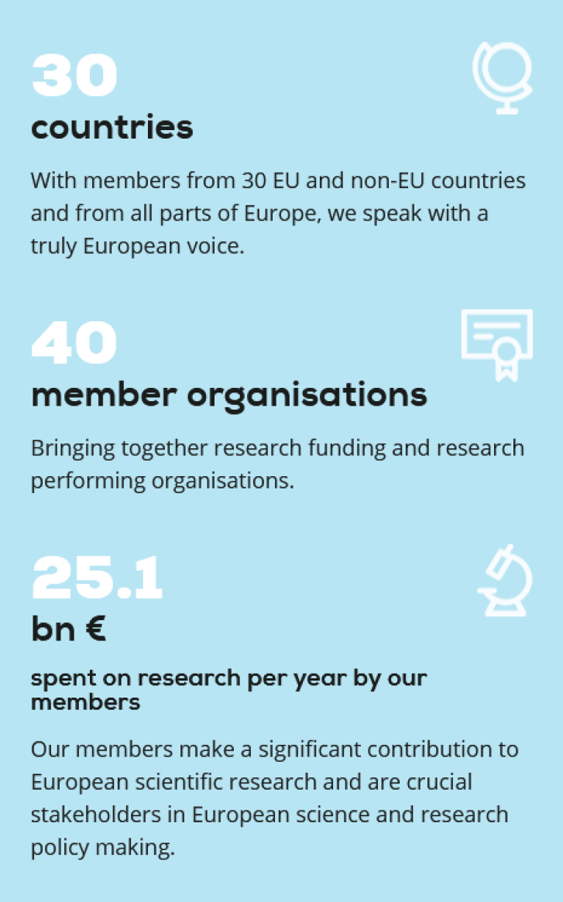
ABOUT SCIENCE EUROPE
Science Europe is the association representing national public organisations that fund and perform research in Europe. One of its three core priorities is to strengthen the role and contribution of science in tackling societal challenges.

Slide 4
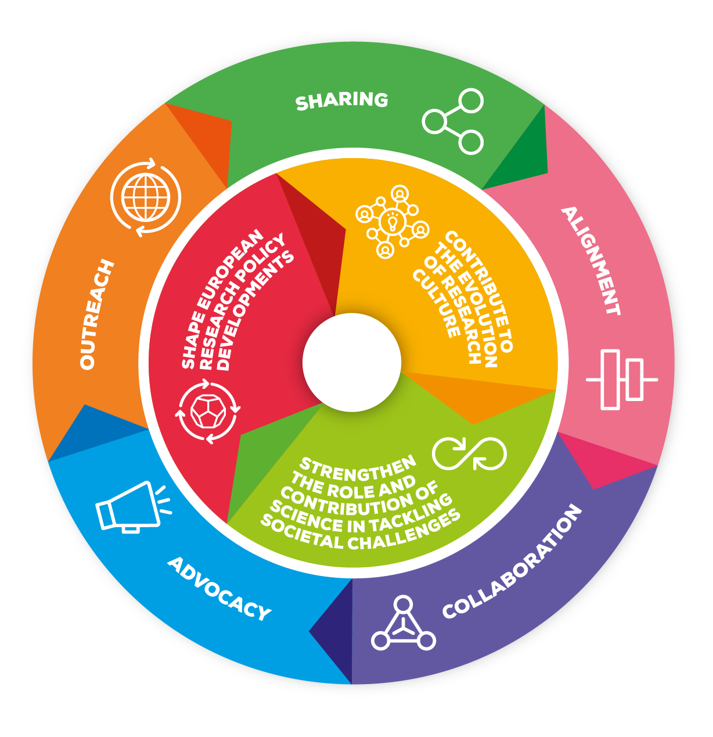





Science Europe Strategy 2021-2026
Share best practices between Member Organisations
Facilitate alignment of policies between Member Organisations
Promote collaboration between Member Organisations
Conduct advocacy of common interests to EU institutions and relevant stakeholders
Develop and support outreach for Science Europe and Member Organisation activities and the promotion of science

Slide 5
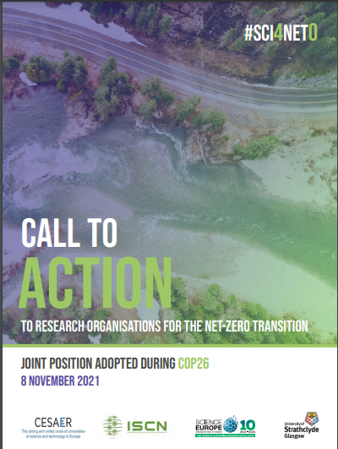
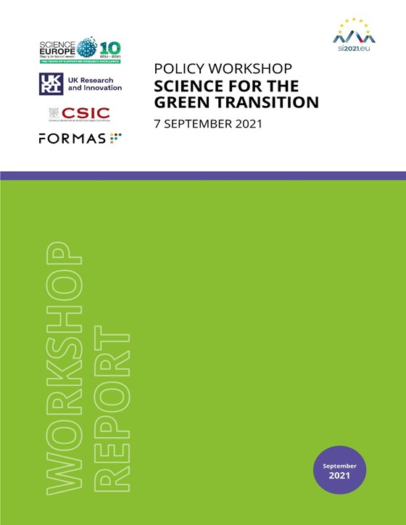

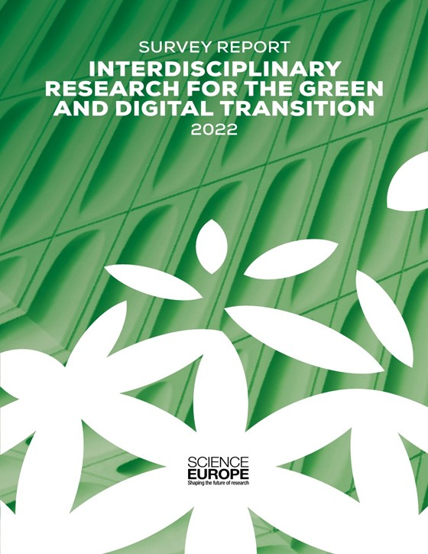
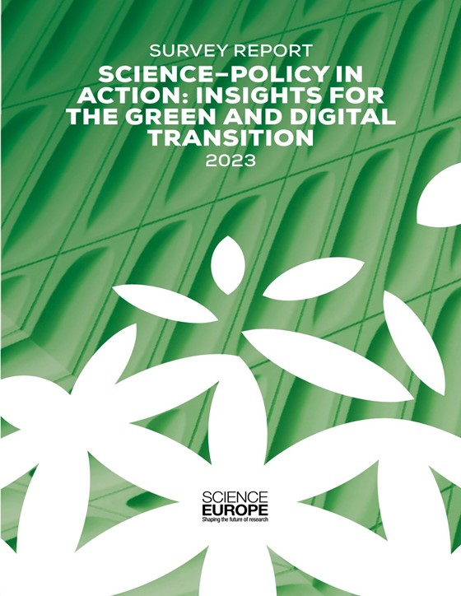
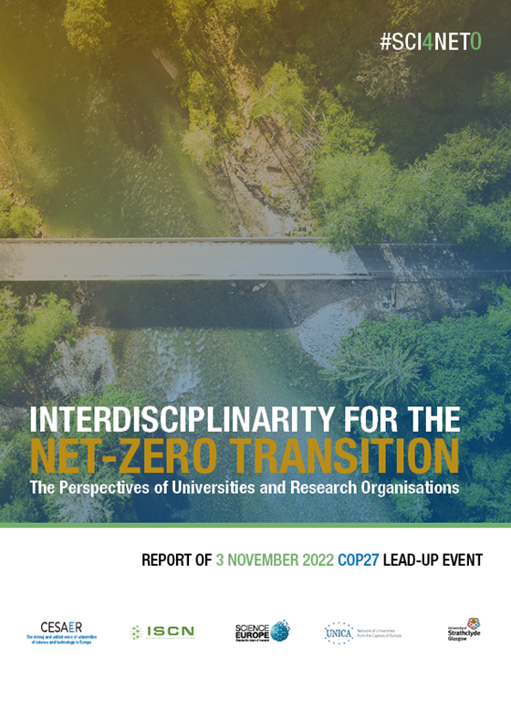

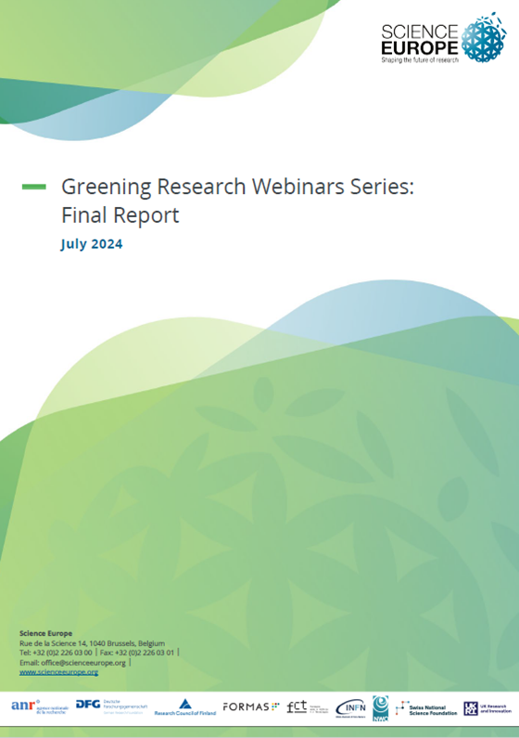
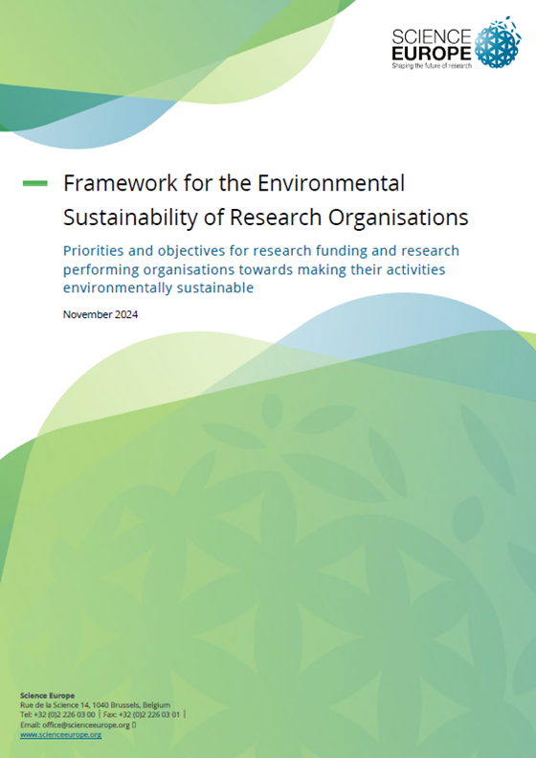


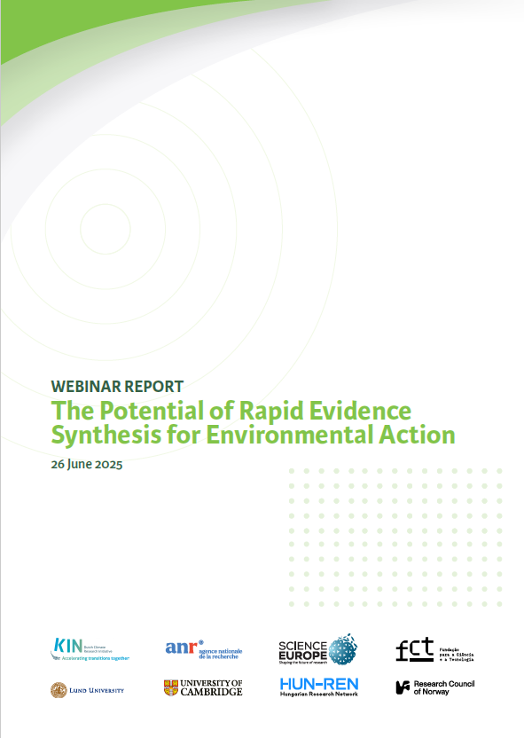

Science Europe's work on sustainability & science for policy

Slide 6
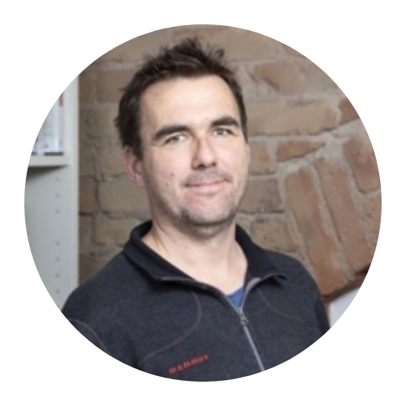
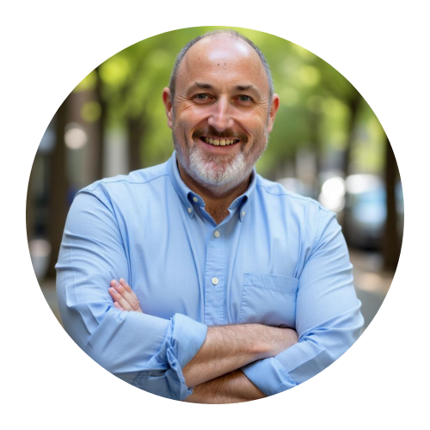
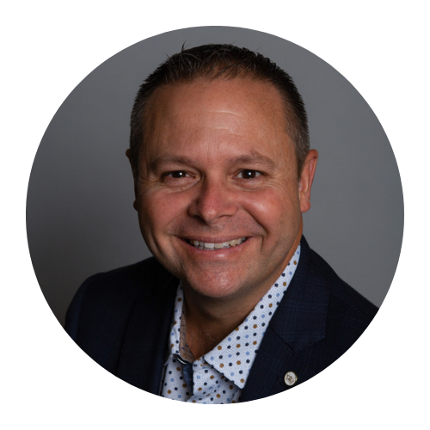

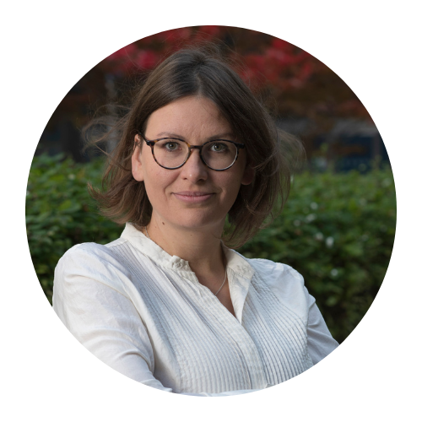
WEBINAR ON THE
Rapid and Living Evidence Synthesis for Environmental Action: Best Practices and Next Steps
Presentations
Latest Advances in Rapid and Living Evidence Synthesis
Moderator
Prof. Dr. Declan Devane
University of Galway
Prof. Dr. Steven J. Cooke
Carleton University
Prof. Dr. Sarah Miller
Queen’s University Belfast
Dr. Biljana Macura
Stockholm Environment Institute and Collaboration for Environmental Evidence
Dr. Jan C. Minx
Potsdam Institute for Climate Impact Research

Slide 7
WEBINAR ON THE
Rapid and Living Evidence Synthesis for Environmental Action: Best Practices and Next Steps
Q&A Session
Dr. Jan C. Minx
Potsdam Institute for Climate Impact Research

Slide 8
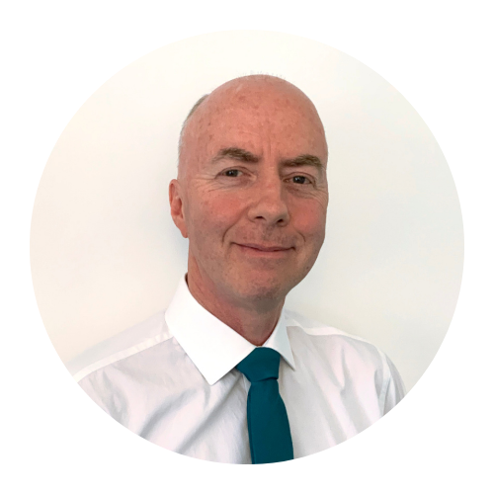
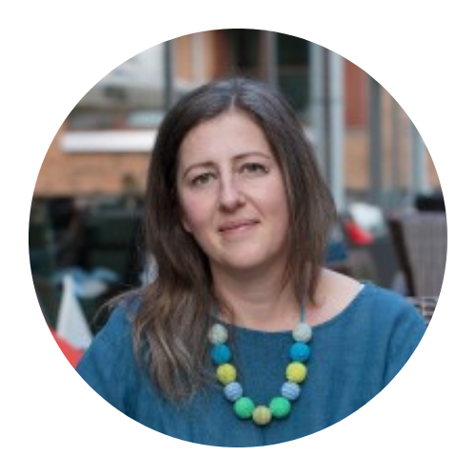
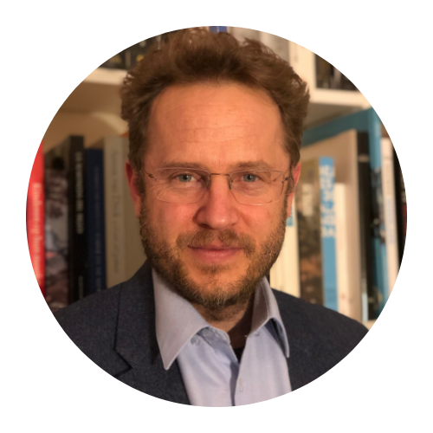
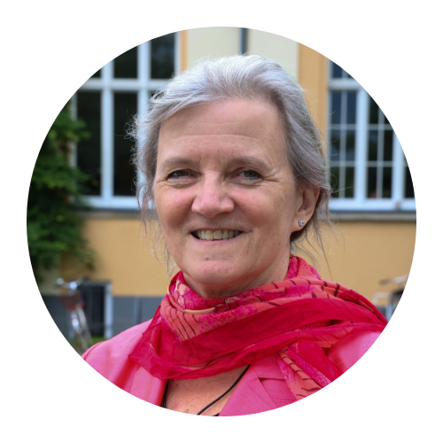
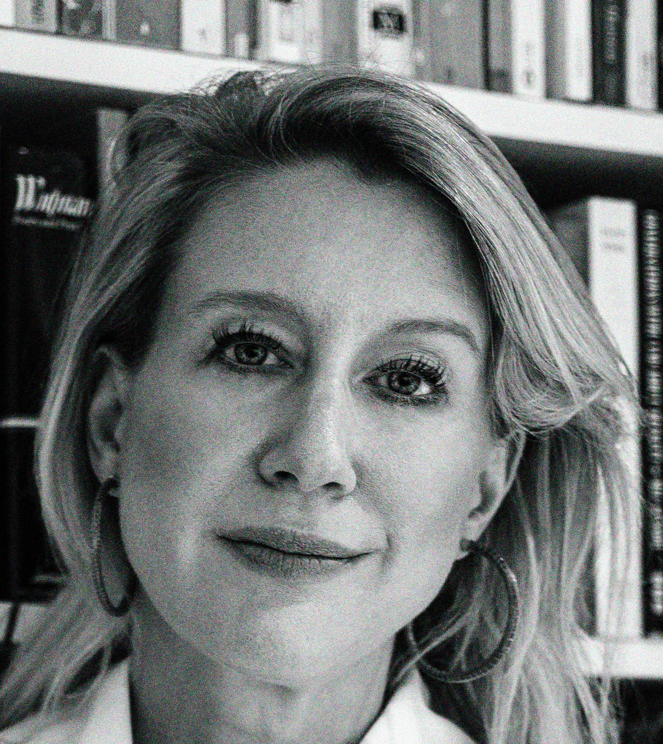
WEBINAR ON THE
Rapid and Living Evidence Synthesis for Environmental Action: Best Practices and Next Steps
Panel Discussion
Rapid and Living Evidence Synthesis: Lessons and Ways Forward for Research Funding and Performing Organisations and Policy-Makers
Moderator
Dr. Rupert Lewis
Natural Environment Research Council
Dr. Eszter Kelemen
ESSRG Nonprofit Ltd.
Dr. Koen Jonkers
JRC Centre for Advanced Studies (S.4), European Commission Joint Research Centre
Prof. Dr. Daniela Jacob
LEUPHANA University Lüneburg
Dr. Eldrid Herrington
University of Cambridge Judge Business School

Slide 9
WEBINAR ON THE
Rapid and Living Evidence Synthesis for Environmental Action: Best Practices and Next Steps
Q&A Session
Dr. Eldrid Herrington
University of Cambridge Judge Business School

Slide 10
WEBINAR ON THE
Rapid and Living Evidence Synthesis for Environmental Action: Best Practices and Next Steps
Concluding Remarks
Dr. Diana Potjomkina
Senior Policy Officer for the Green Transition, Science Europe

