Slide 1
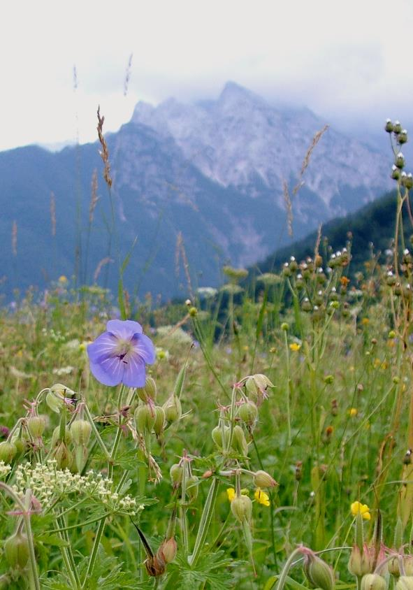
Using AI in (rapid) evidence synthesis: some personal insights
Eszter Kelemen (ESSRG)
Webinar on Rapid and Living Evidence Synthesis
27-04-2026

Slide 2
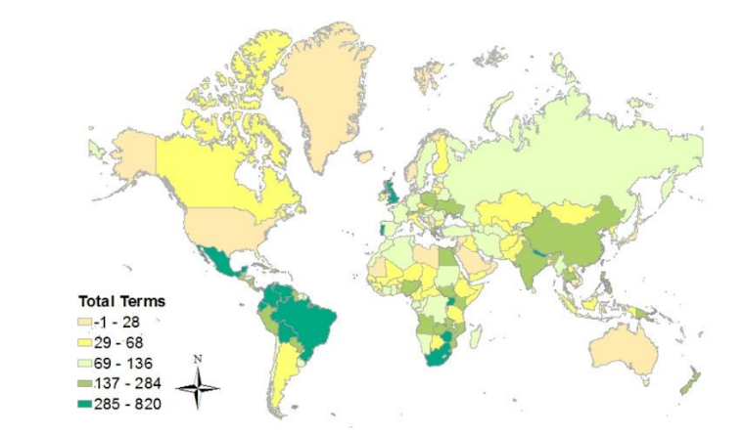
An IPBES-experience
IPBES Values Assessment (2019-2022)
How nature’s values are represented in national constitutions?
LLM developed and tailored by the IPBES Data and Knowledge Task Force
Reliable evidence base, several iterations to refine the bag of words and teach the model
Wide coverage but not necessarily rapid
Fig.6.2 The total number of times terms (potentially) associated with values of nature was mentioned in 196 national constitutions. Source: IPBES VA (2022) Annex to Chapter 6.

Slide 3
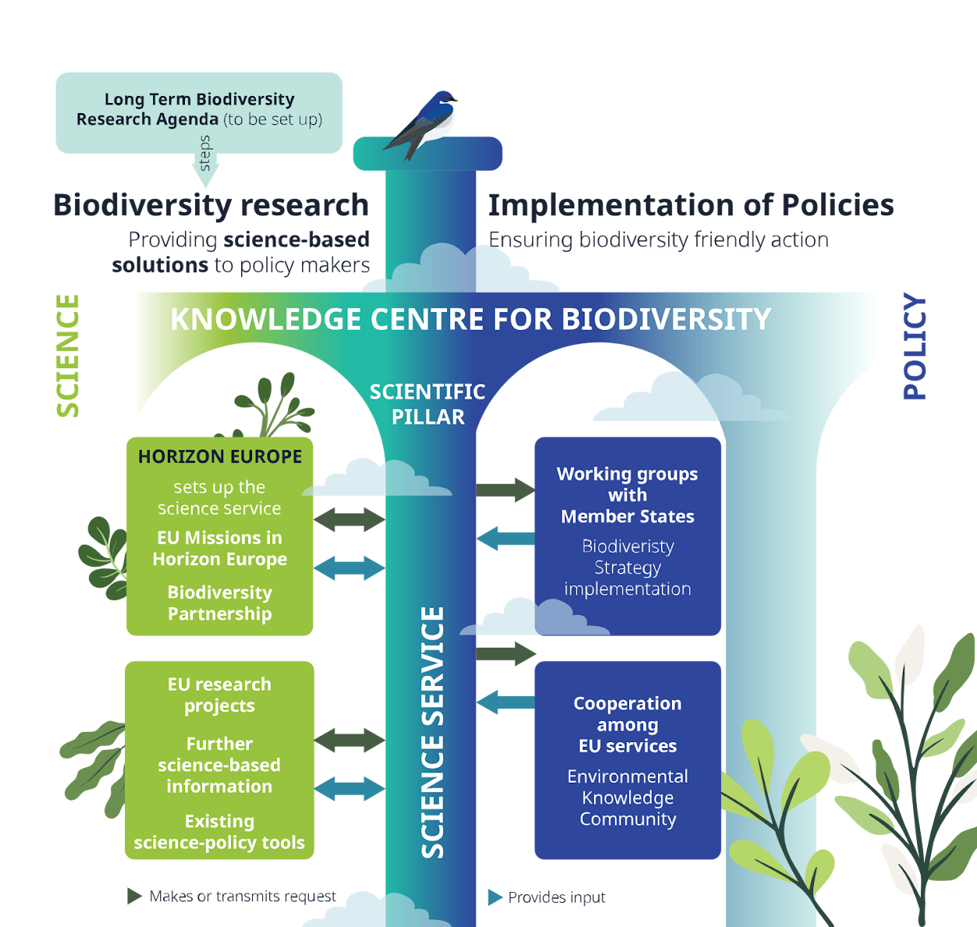
A European example:
The Science Service for Biodiversity
Outlined by the EU Biodiversity Strategy 2030
Aiming to bridge European-level decision-making with diverse knowledge holders
Being set up by the BioAgora project, https://bioagora.eu/
Currently in testing phase, officially launched in 2027

Slide 4
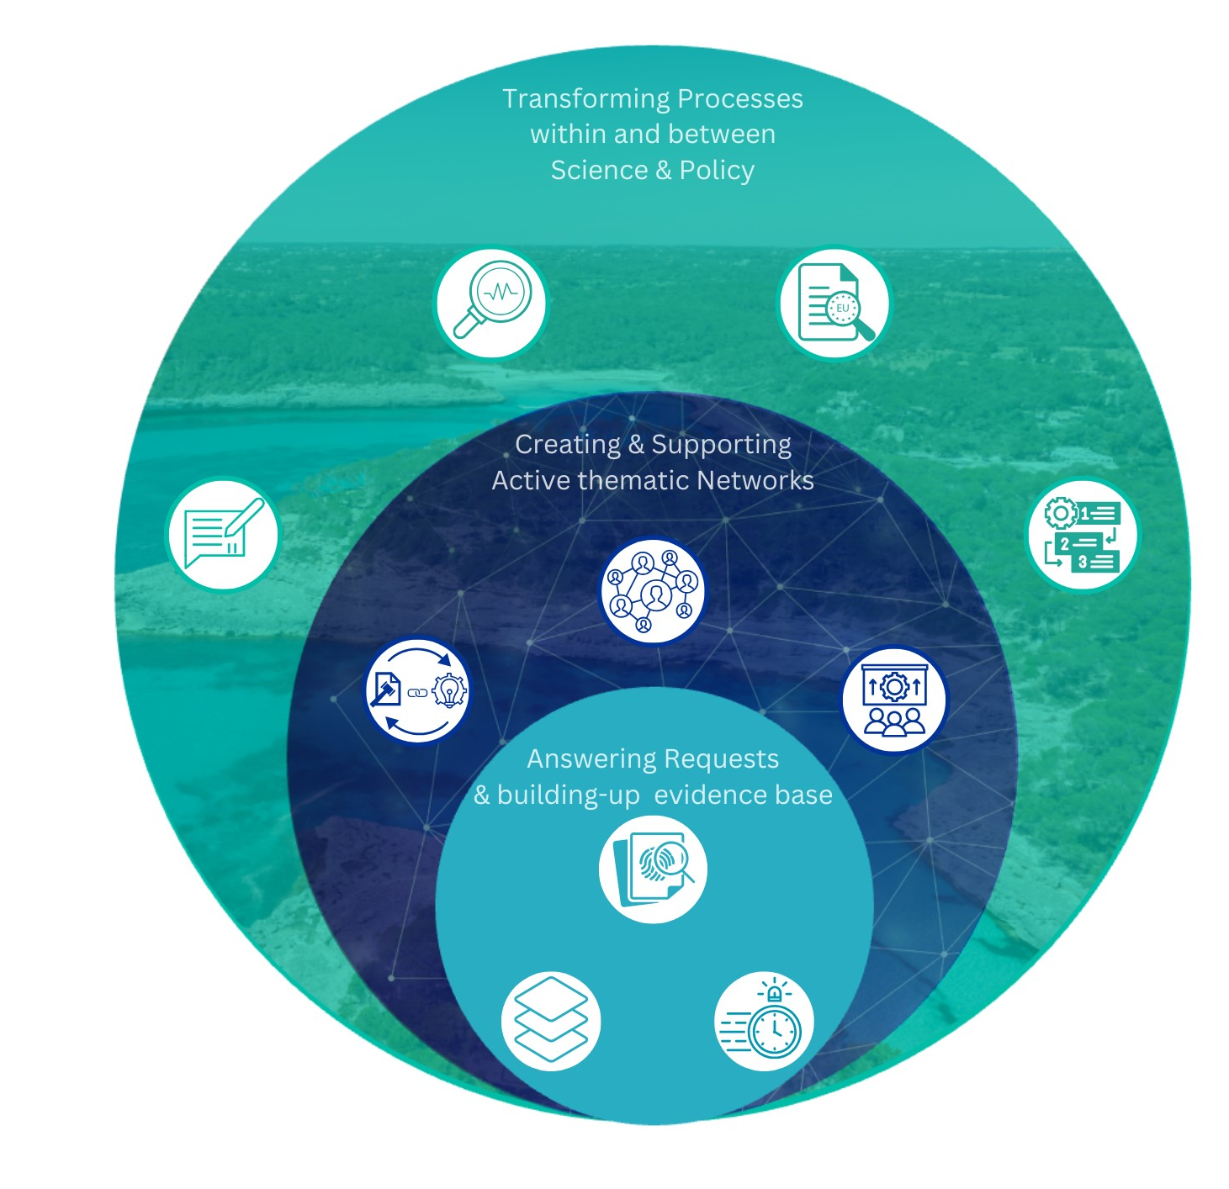
The three main functions of the Science Service

Slide 5

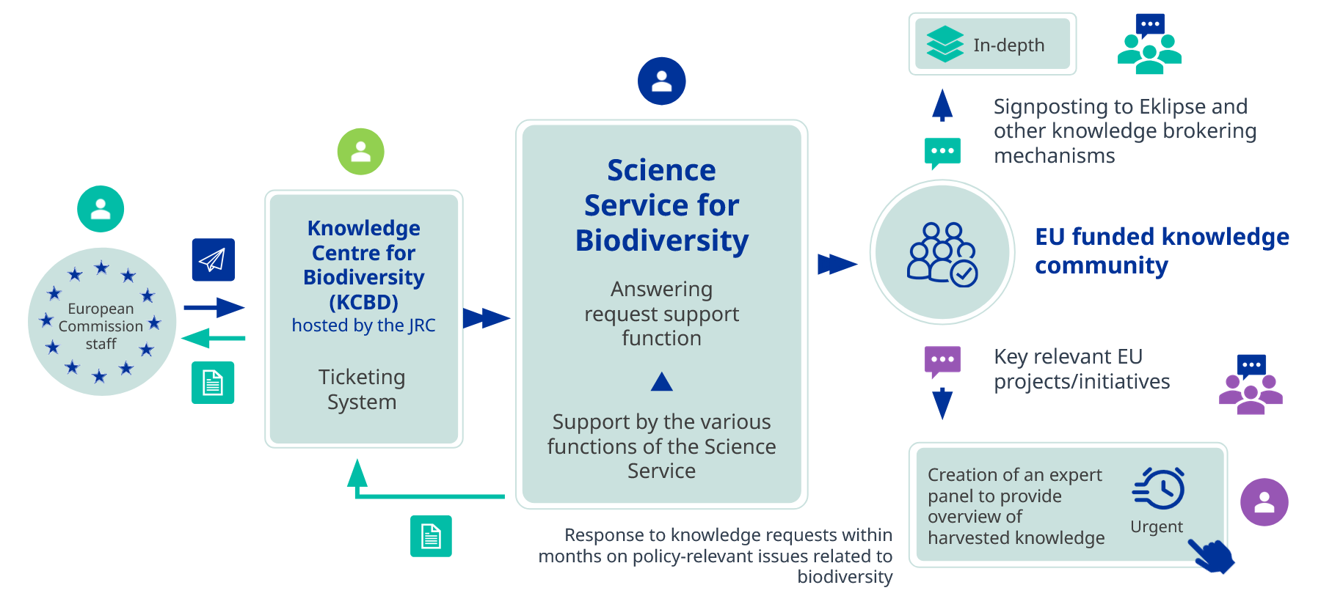
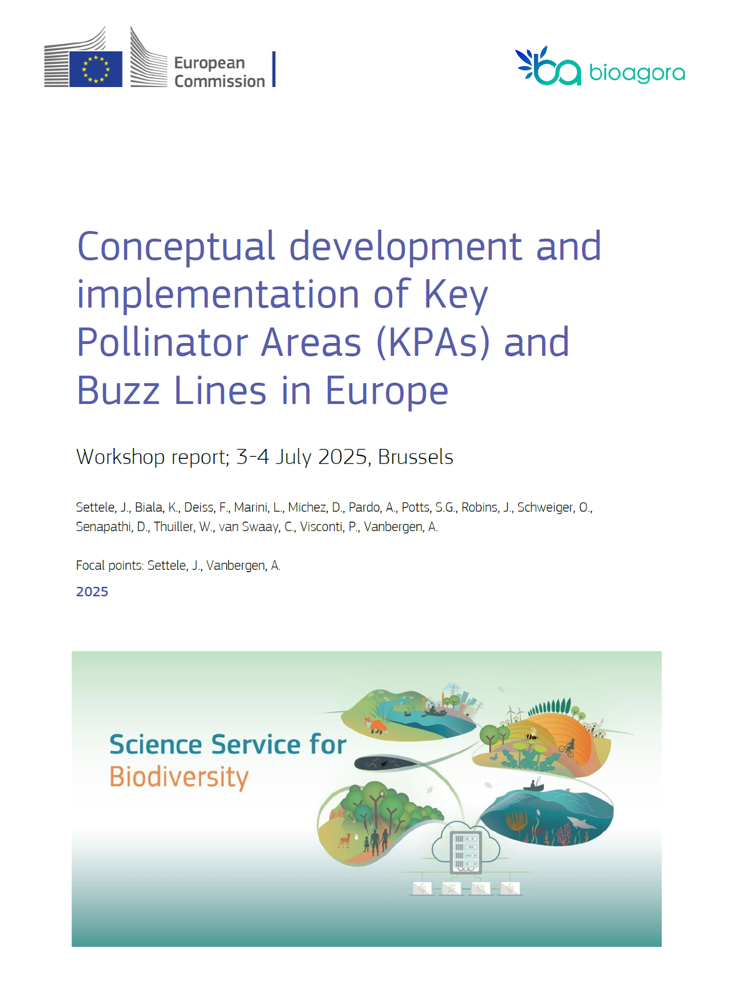
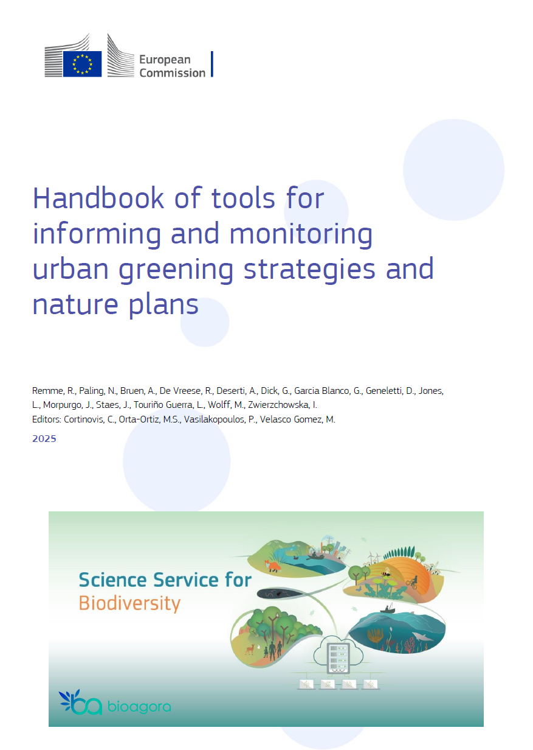
The answering request function in a nutshell

Slide 6
Using AI in the Science Service
Currently under development / testing
Potential places for integration:
  Scoping/Reception phase, e.g. carrying out a „Human Dimension Review” to assess the relevance of social scientific disciplines and participatory approaches
  Knowledge overview phase, e.g. doing a rapid evidence synthesis with AI and then invite the expert panel to complement / debate / validate the results
  …

Slide 7
Dilemmas and concerns
How to ensure reproducability and robustness?
How to ensure that only reliable evidence base – but all relevant evidence – is used by the AI model?
Shall we use one or more AI models simultanously? (i.e., cross-checking results, identifying gaps or contradictions)
Who should run the model(s) – a central „data” task force, or the involved researchers?
How to ensure that researchers have the necessary skills and capacities to work with AI? Do we need researchers working at the SPI to have a general AI-literacy?

Slide 8
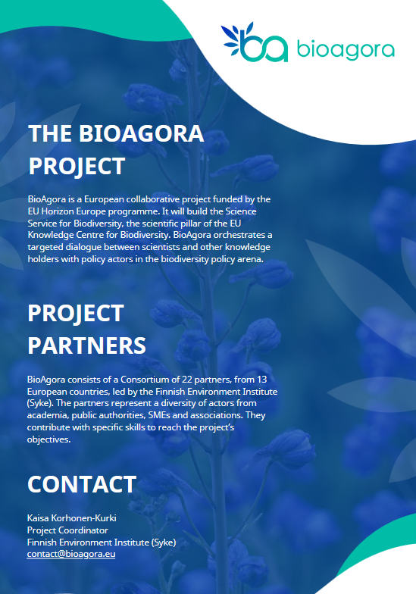

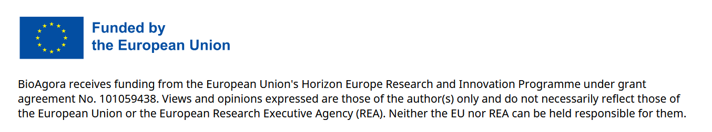
kelemen.eszter@essrg.hu
https://bioagora.eu/
https://scienceserviceforbiodiversity.eu/

