Slide 1



Rapid Review Reality Check
Steven J. Cooke
Canada Research Professor
Carleton University
Ottawa, Canada
Canadian Centre for Evidence-Informed Conservation
WWW.FECPL.CA

Slide 2


About Systematic Reviews…
Assumption – Systematic Review is the GOLD STANDARD
SRs are able to reduce/control bias
  Inherently exclusionary of evidence and voices from marginalized communities such that opportunity for significant bias (fail to adequately include considerations of equity, diversity, inclusion and justice)
SRs require long periods of time to complete
  They can be quick if resourced appropriately (164 d on avg)
SRs provide decision makers with exactly what they need to make the best decisions
  Institutions often have bespoke science advice and decision-making processes to fit their given context and often SRs do not always fit within them
Notes:
The qualitative analysis suggests that this inconsistency between confidence and use is due to the opportunistic use of evidence syntheses. Decision-makers reported being constrained by what is available to them.
For example, this quote from a participant fro fisheries and oceans Canada….
This was particularly true for the more trusted options, which are extremely resource intensive and require high levels of analytical expertise.
For time-sensitive or emerging issues more rapid forms are highly valuable and thus used more often.

Slide 3
About Rapid Reviews…
Why Rapid Reviews?
Lack of sufficient resources is often invoked as reason that SRs take a long time – decision makers need to make a decision NOW
For rapid reviews the idea is that shortcuts are taken to expedite the process
Shortcuts include…
Narrower question/ignoring sub-questions
Fewer databases
Restricted search for grey literature
Less robust screening processes
Simplified data extraction
Limited critical appraisal
The “rapid” narrative fails to consider that it may be necessary to customize protocols to fit with context and institutional processes
Notes:
The qualitative analysis suggests that this inconsistency between confidence and use is due to the opportunistic use of evidence syntheses. Decision-makers reported being constrained by what is available to them.
For example, this quote from a participant fro fisheries and oceans Canada….
This was particularly true for the more trusted options, which are extremely resource intensive and require high levels of analytical expertise.
For time-sensitive or emerging issues more rapid forms are highly valuable and thus used more often.

Slide 4
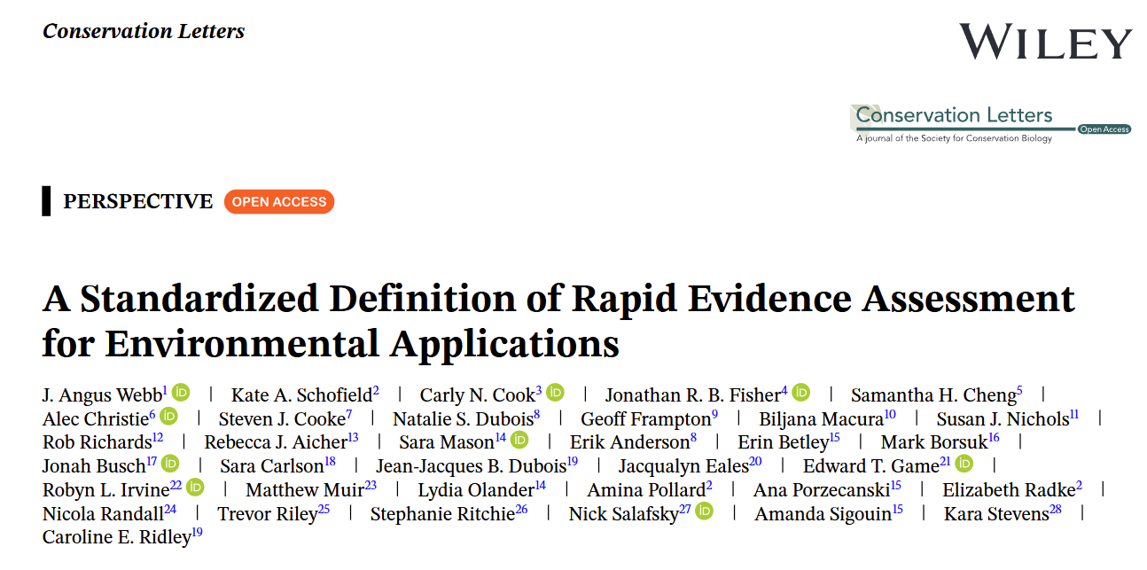
About Rapid Reviews…
Rapid Evidence Assessment is a structured review process that aims to maximize rigor and objectivity given assessment needs and resource constraints; is transparent about trade-offs, risks and biases; and can integrate multiple types of evidence.
Notes:
The qualitative analysis suggests that this inconsistency between confidence and use is due to the opportunistic use of evidence syntheses. Decision-makers reported being constrained by what is available to them.
For example, this quote from a participant fro fisheries and oceans Canada….
This was particularly true for the more trusted options, which are extremely resource intensive and require high levels of analytical expertise.
For time-sensitive or emerging issues more rapid forms are highly valuable and thus used more often.

Slide 5
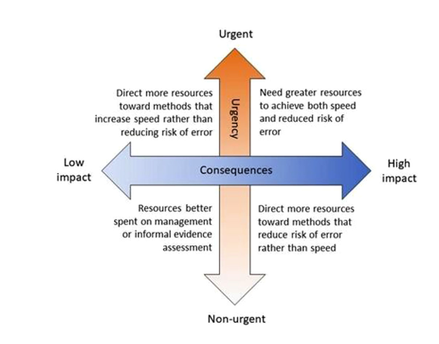
About Rapid Reviews…
Not every decision is equivalent
Notes:
The qualitative analysis suggests that this inconsistency between confidence and use is due to the opportunistic use of evidence syntheses. Decision-makers reported being constrained by what is available to them.
For example, this quote from a participant fro fisheries and oceans Canada….
This was particularly true for the more trusted options, which are extremely resource intensive and require high levels of analytical expertise.
For time-sensitive or emerging issues more rapid forms are highly valuable and thus used more often.

Slide 6
A Misnomer?
Rapid Review is a misnomer – reasons for deviating from the SR “gold standard” more nuanced than just speed/urgency
It is about customizing processes to best suit the needs of evidence user – which may NOT be rapid at all…

Slide 7

About Rapid Reviews in Practice
The Canadian Science Advisory Secretariat (CSAS) is the mechanism by which DFO provides peer-reviewed science advice
Relies on experts involved with interpreting various syntheses at workshops to generate consensus science-based management guidance
Involves key stakeholders and rightsholders

Slide 8
Where to Rapid Reviews Fit In?
80
Evidence syntheses vary in their reliability
60
Selected in top 3 (%)
40
20
0
Meta analyses
Narrative reviews
Systematic reviews
Causal criteria
Vote counting
Summaries and synopses
Conceptual models
Systematic maps
Rapid reviews
More rigorous, slower
Less rigorous, more rapid
Confident
Use
Thomas-Walters, Cooke et al. 2022. Cons. Sci. Pract.
Notes:
The qualitative analysis suggests that this inconsistency between confidence and use is due to the opportunistic use of evidence syntheses. Decision-makers reported being constrained by what is available to them.
For example, this quote from a participant fro fisheries and oceans Canada….
This was particularly true for the more trusted options, which are extremely resource intensive and require high levels of analytical expertise.
For time-sensitive or emerging issues more rapid forms are highly valuable and thus used more often.

